Slide 1
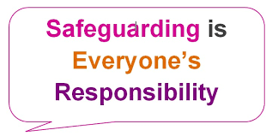
Safeguarding at
Uxendon Manor Primary School
Safeguarding is the action that is taken to promote the welfare of children and protect them from harm.
Safeguarding means:
protecting children from abuse and maltreatment
preventing harm to children’s health or development
ensuring children grow up with the provision of safe and effective care
taking action to enable all children and young people to have the best outcomes.
‘Safeguarding and promoting the welfare of children is everyone’s responsibility. Everyone who comes into contact with children and their families has a role to play.’
This means everyone including those visiting the school have a responsibility to report instances of actual or suspected abuse or neglect to the Designated Safeguarding Leads (DSLs).
If you have a concern about your child's safety in school, never delay...speak to us straight away. Your child's class teacher of year group leader are key starting people. If you feel it is more serious a member of the Safeguarding team will meet you.
If a disclosure is made, the DSL will be following the Safeguarding Policy (please see school website) and referring the case to social care.

Slide 2
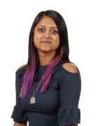
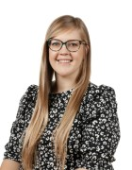



Contacts
If you have any concerns about a child, please contact one of the following staff members:
Mrs Devakumar (DSL)
Miss van der Sluys (DDSL)
Miss Merlin (DDSL)
Telephone: 020 8907 5019
Email: Safeguarding@uxendonmanor.com
Alternatively, you can call Brent Children's services on 020 8937 4300
Or report your concerns at: https://www.brent.gov.uk/children-young-people-and-families
For further information, please visit the school website: https://www.uxendonmanor.com/safeguarding/

